Slide 1


Project 3 brief
Catherine Miao

Slide 2
The Gallic War, published on the eve of the civil war which led to the end of the Roman Republic, is an autobiographical account written by one of the most famous figures of European history. On one level a straightforward narrative of the campaigns Caesar fought against the Gauls, Germans and Britons, it also serves a deeper political purpose, revealing him as a commander of breathtaking flair, courage and persistence - a man of the people, a man without rival.

Slide 3
1944, in the ruined wine cellar of a Tuscan villa, as bombs fall around them, two strangers meet and share an extraordinary evening

Slide 4
In a peaceful retirement village, four unlikely friends meet up once a week to investigate unsolved murders.

Slide 5
No one loves and quarrels, desires and deceives as boldly and brilliantly as Greek gods and goddesses. They are like us, only more so - their actions and adventures scrawled across the heavens above, from the birth of the universe to the creation of humankind.

Slide 6
Stakeholder The Leeds library
CEO & librarians

Slide 7
The problem try to solve
Have a piece of description about the book, How do we know which category it belongs to
Target: categories : Fiction, Non Fiction
Feature: a piece of summary about book

Slide 8
Feature extrcation
Bag of words is a Natural Language Processing technique of text modelling
is a representation of text that describes the occurrence of words with in a document.
TF-IDF
Term Frequency:is a scoring of the frequency of the word in the current document
Inverse Document Frequency: is a scoring of how rare the word is across documents.
The scores have the effect of highlighting words that are distinct (contain useful information) in a given document.

Slide 9
Which model to choose?
Try different models
K-Nearest Neighbor, Support Vector Machine and Logistic Regression

Slide 10
How will I meansure success?
Binary Cross Entropy
Confusion Matrix
ROC AUC score
: combining TPR, FPR
It can be easily explained to business stakeholders. If they want to choose the threshold that fits the business problem.
Cohen Kappa Metric

Slide 11
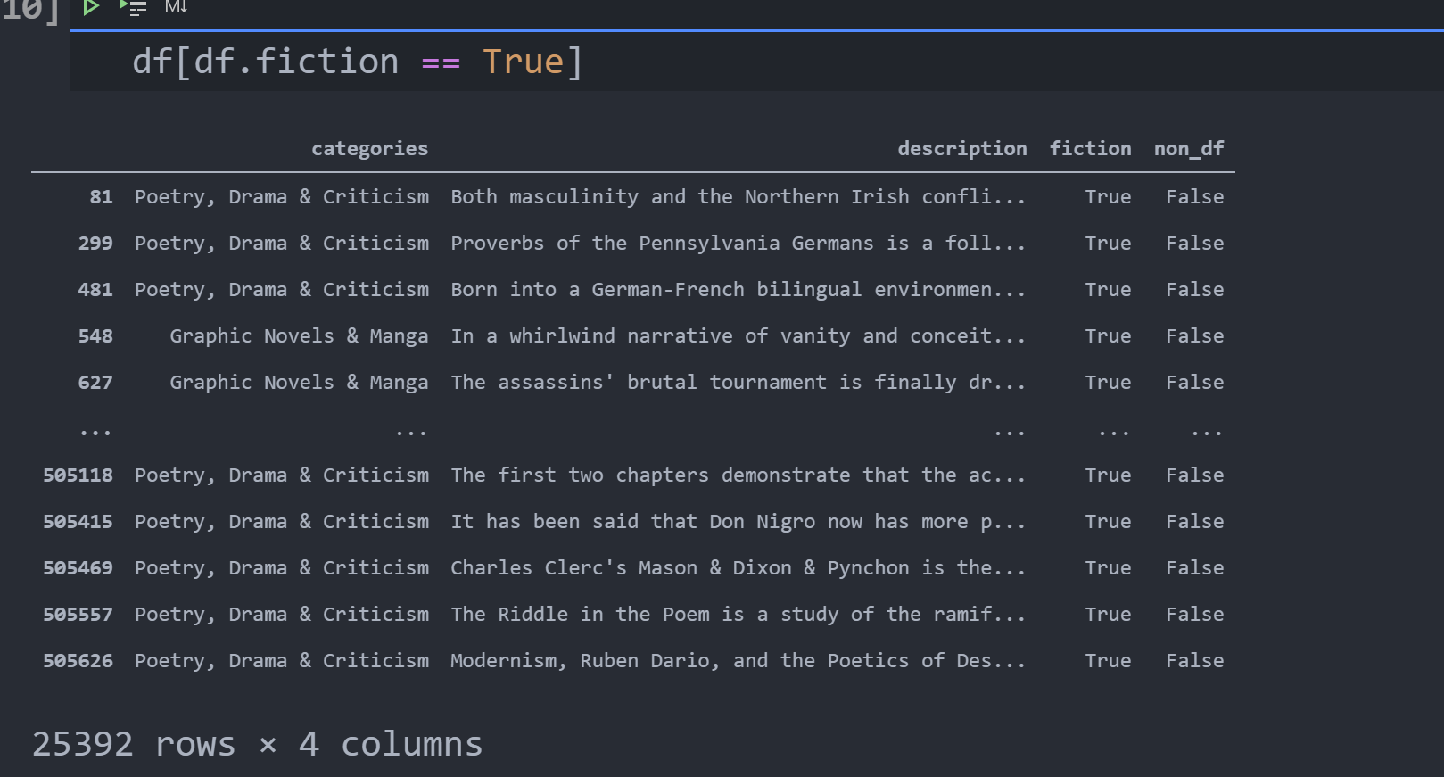

Slide 12
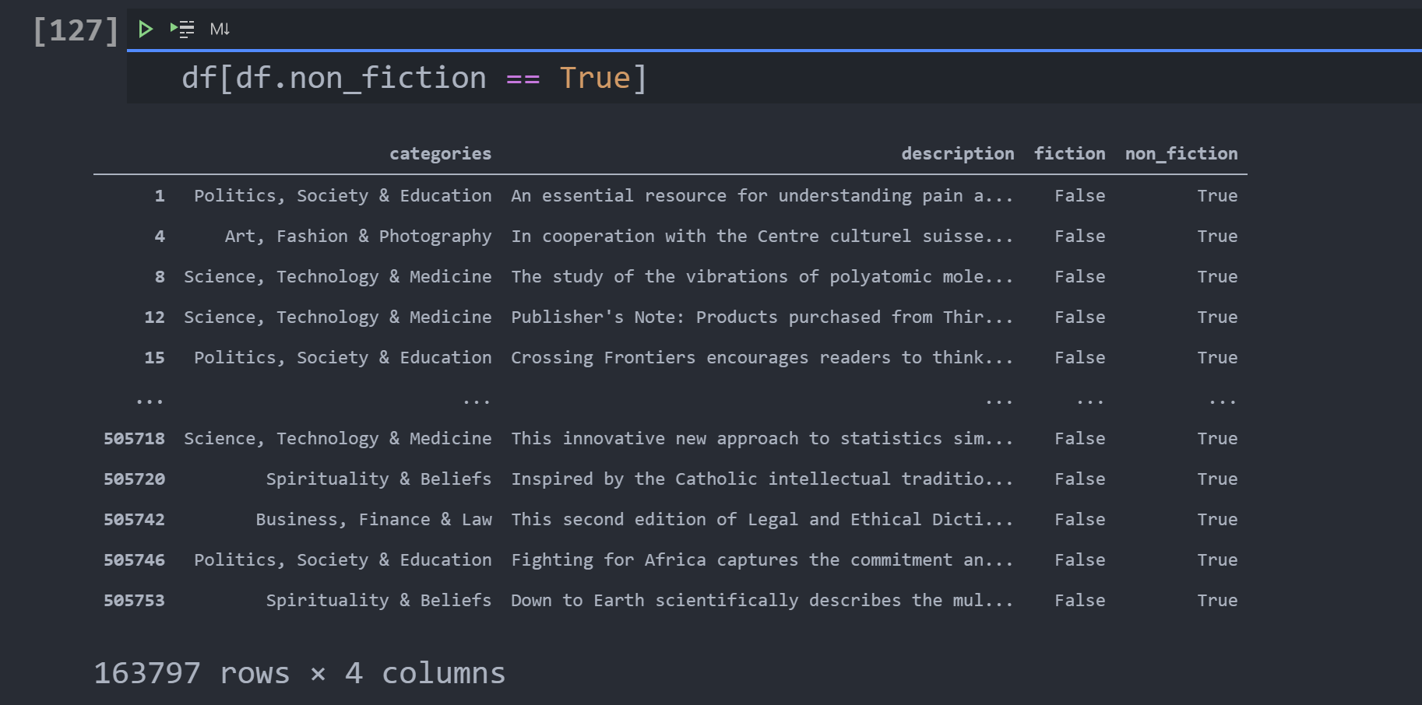

Slide 13
Thank You

